Slide 1
WHAT HAVE YOU LEARNT TILL NOW?
1
Until now, you have learnt the following CRUD operation.
C – Create a new record in the database
R – Read a record and understand its content
2
3
U – Update some values in the record
D – Delete a record from the database
4

Slide 2
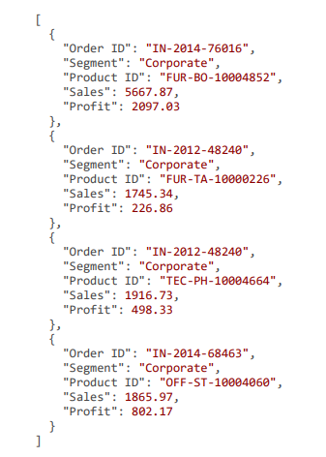
UNDERSTANDING THE DATASET
In this session, you will learn some basic fundamental querying techniques available in MongoDB.
Before moving on to the querying part, let’s discuss the dataset that we will be using.
The dataset comprises the order information for a retail giant, which appears as on the right hand side.

Slide 3
DATA DICTIONARY
Order ID
Segment
Product ID
Sales
Profit
Each order has a unique Order ID, which is stored in the following pattern:
*Country Code*- *Year of Purchase*- *Order No*
Example: IN-2014-76016
Corporate, Consumer or Home Office
Each product being purchased has a unique pattern as shown below:
*Product Category*- *Product Sub-category*- *Product No*
Example: FUR-BO-10004852
Sales made by the order
Profit made by the order

